Slide 1
Friday, April 23, 2021

Slide 2
What is Day of Silence?
Created in 1996 and hosted each April, Day of Silence is observed with a daylong vow of silence symbolizing the silencing effect of anti-LGBTQ+ bullying and harassment.
This year’s Day of Silence takes place on Friday, April 23rd, and students from all 50 states and many different countries will participate.
Notes:
4 in 5 students don’t see positive LGBTQ+ representation in their curriculum; nearly 9 in 10 experience verbal harassment; and almost a third miss school because they feel unsafe.

Slide 3
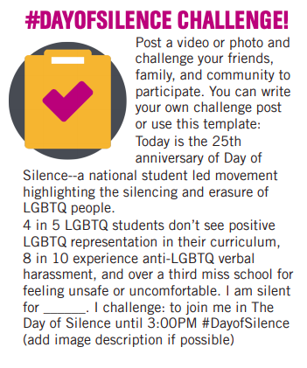
Join Us By...

